Slide 1
Data Visualization of US Bureau of labor and statistics June 23, 2018
By:
Paul G. Arias
JAN Olechowski
Anthony Cusumano

Slide 2
Motivation:
To build a website with appeal that would look interesting and inviting to tell a story about the current job market.
To answer the question: Where are people currently employed and what are they doing?
The challenge being to display this data in a way that is both enticing and exciting.
Doing so, takes you on a journey of wonder and intrigue.
Along the way it tells you an enjoyable and page-turning data story.

Slide 3
Motivation:
Ever been to a website that seemed so busy and so full of stuff it just left you confused?
Or worse yet, you are surfing the web and you came upon a very dry and boring site. How long did you stay before you went on?
Ever research the job market? No doubt one of your stops was the Bureau of Labor and Statistics website.

Slide 4
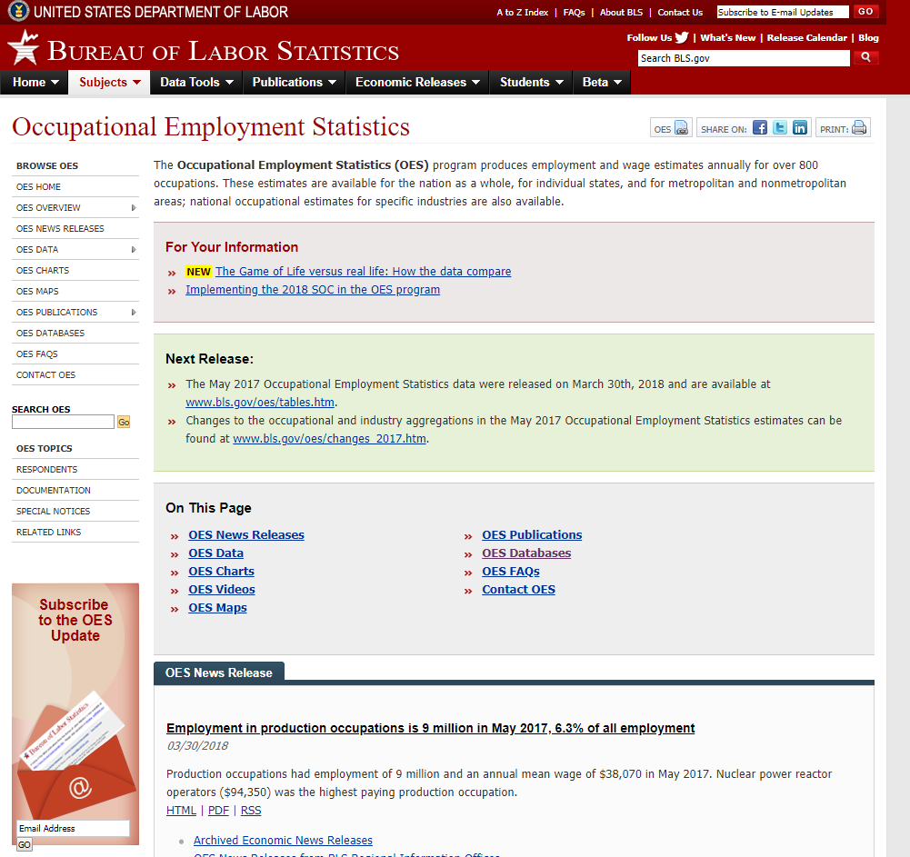

Slide 5
US DEPARTMENT OF LABOR –BUREAU OF LABOR STATISTICS WEBSITE
What comes to mind when you see a site like this?
Busy/Confusing
Where to begin? Next website?
The data is (DOA) Dead On Arrival.

Slide 6


Except for the really committed!
Others just give up! Often leading to Depression and Hopelessness feeling:
OPPORTUNITY is NOWHERE !

Slide 7

Well my friends, here comes the sun!
One of the things we do as Data Analysts is tell a story with our data!
We create dazzling visualizations to make even a boring website’s information shine brilliantly.

Slide 8
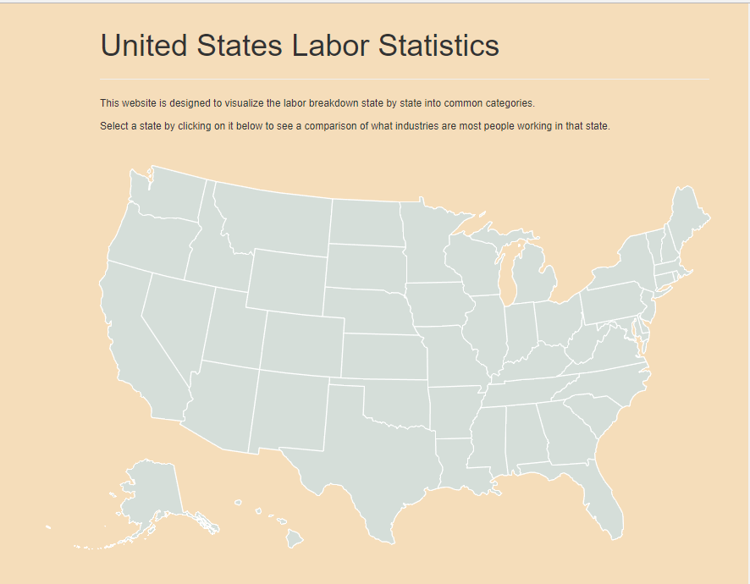
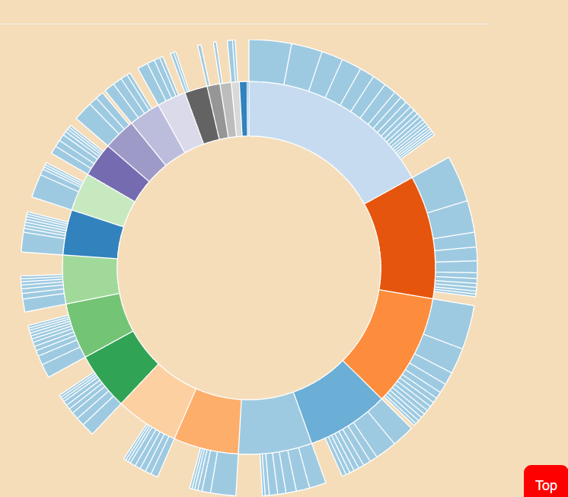
URL Link: https://ublsrudatasci.herokuapp.com/
OPPORTUNITY is NOW-HERE !

Slide 9

It says United States Labor Statistics but is clearly not the same site.
Check out the map and diagram! Super!
How many of you if you came upon a site like this while surfing the web will at least click around a bit?
Check out the trends and job markets? What parts of the country have which jobs?
Exactly! It's got what I call website appeal.
Makes you want to click around it all day.

Slide 10
Let me go over some of the cool parts for you. So if you hover any state it says the name of the state and when you click it, an exciting starburst comes up. How great is that? Super!
Hovering over this starburst shows us a hierarchy of job categories in that state by employment and the lower lever shows jobs and employment numbers within it. Amazing!
For my part, I am interested in those in the analyst space. It is so easy to get to, as you can see.
My part of the code was in producing SQLite databases and csv files from the BLS website and providing that data for these to query.
My colleagues, Paul and Jan, will now tell you about the code and development and will conclude with final thoughts.
**************************************************************************************************
This screen will mainly exist be on an index card I will have at time of presentation as we cut to the actual website and I click around showing some detailed information and then introducing you to continue.]

